Slide 1
Introduction to Interpreter
Course Code: CSE 309 Course Title: Object Oriented Programming II : Visual and Web Programming

Slide 2
C code
Python

Slide 3
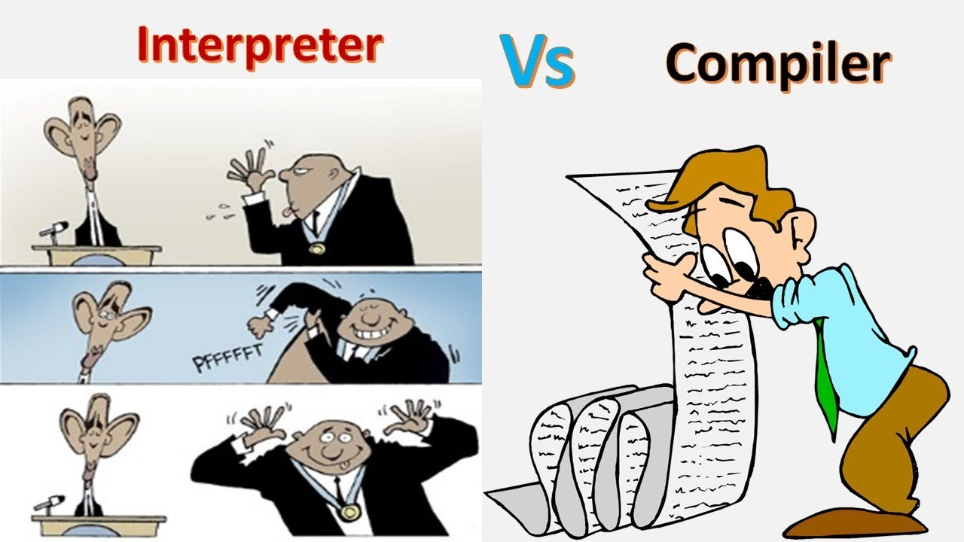

Slide 4
Interpreter VS Compiler
No | Compiler | Interpreter
1 | Compiler Takes Entire program as input | Interpreter Takes Single instruction as input .
2 | Intermediate Object Code is Generated | No Intermediate Object Code is Generated
3 | Memory Requirement : More(Since Object Code is Generated) | Memory Requirement is Less
4 | Program need not be compiled every time | Every time higher level program is converted into lower level program
5 | Errors are displayed after entire program is checked | Errors are displayed for every instruction interpreted (if any)

Slide 5
Compiler VS Interpreter
No | Compiler | Interpreter
1 | Compiler Takes Entire program as input | Interpreter Takes Single instruction as input .
2 | Intermediate Object Code is Generated | No Intermediate Object Code is Generated

Slide 6
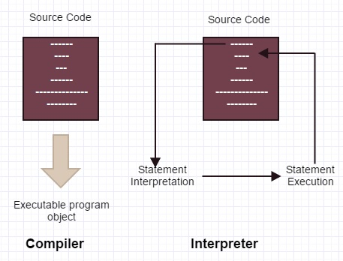
Compiler VS Interpreter

Slide 7
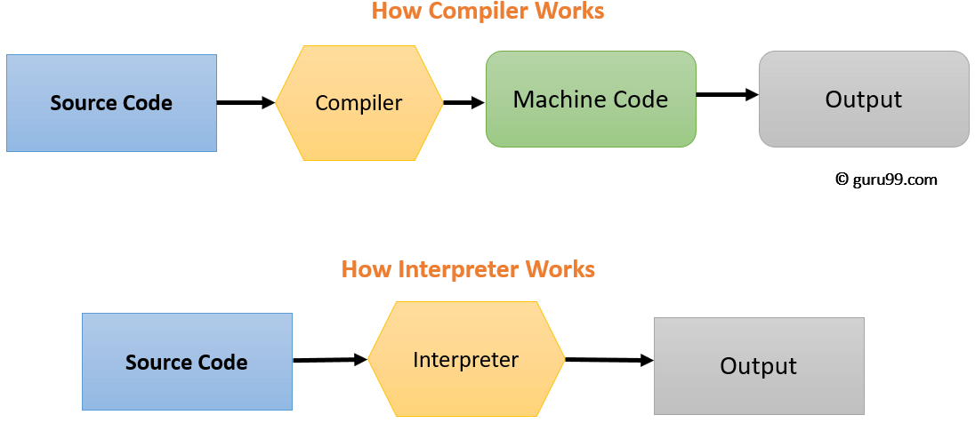
Compiler VS Interpreter

Slide 8


Compiler VS Interpreter
3 | Memory Requirement : More(Since Object Code is Generated) | Memory Requirement is Less

Slide 9
Compiler VS Interpreter
4 | Program need not be compiled every time | Every time higher level program is converted into lower level program

Slide 10
Compiler VS Interpreter
5 | Errors are displayed after entire program is checked | Errors are displayed for every instruction interpreted (if any)

Slide 11


